Slide 1
Why R?
RX 319
Introduction to Healthcare Analytics

Slide 2
Learning Objectives
Describe the goal of computer programming.
Contrast “high-level” and “low-level” programming languages.
Compare & contrast R with Excel.
Contrast R and RStudio.
2

Slide 3

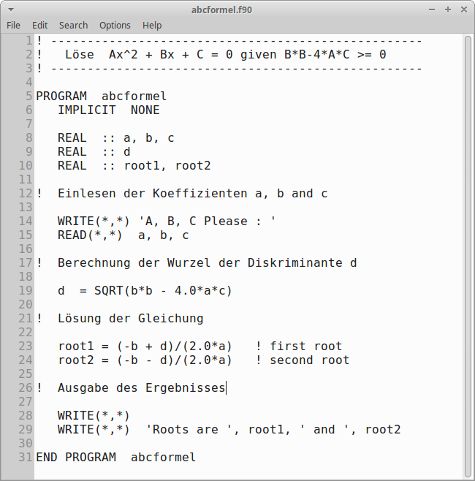
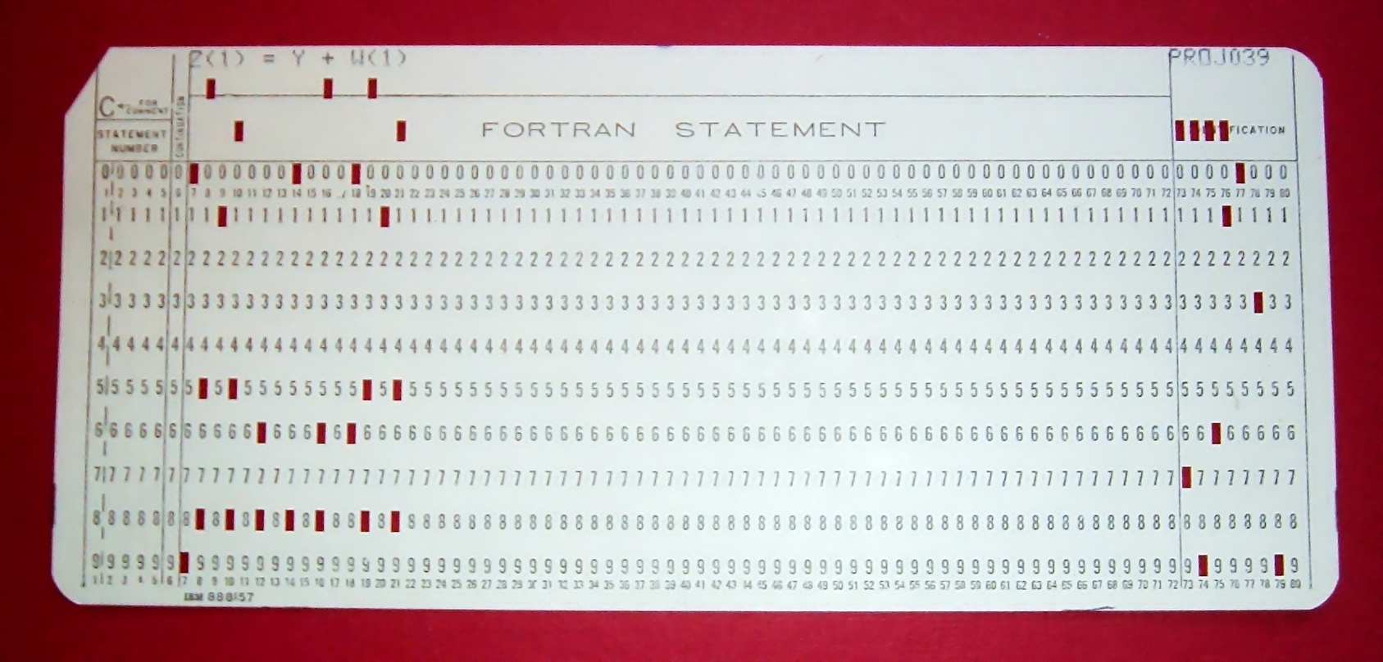
Yup, programming
Giving instructions to a computer
No, it’s not “easy”
It’s a lot easier than it used to be though
Sources:
https://images.nasa.gov/
Wikimedia Commons
3

Slide 4


R is a “high-level” language
C READ THE NUMBER OF INPUT VALUES READ 10, N 10 FORMAT(I3) C READ THAT MANY NUMBERS, STORING ABSOLUTE VALUES DO 20 I = 1, N READ 30, DTA(I) 30 FORMAT(F10.6) IF(DTA(I)) 25,20,20 25 DTA(I) = -DTA(I) 20 CONTINUE C COMPUTE THE SUM OF THE NUMBERS SUM = 0.0 DO 40 I=1, N SUM = SUM + DTA(I) 40 CONTINUE C COMPUTE AND PRINT THE AVERAGE AVG = SUM/FLOAT(N) PRINT 50, AVG 50 FORMAT(1H ,F10.6) STOP END
Calculating an average in Fortran
Calculating an average in R
mean(numbers)
Low Level
(Computer Language)
Assembly Language
R, SQL
High Level
(People Language)
C, Fortran
Glue Language: A programming language that connects to other software and programming languages
4
Source: Bennet T. http://sandbox.mc.edu/~bennet/cs404/doc/ave_f.html

Slide 5
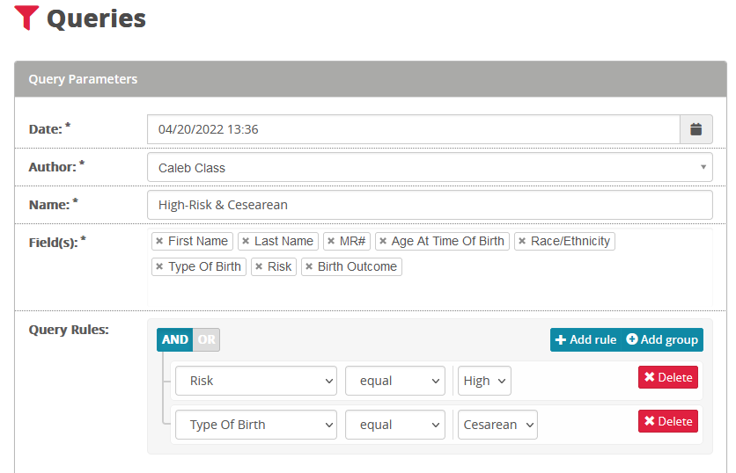
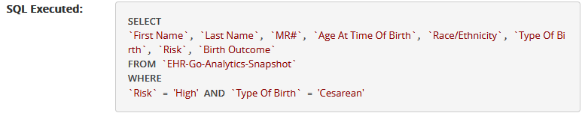
You already did it!
5

Slide 6
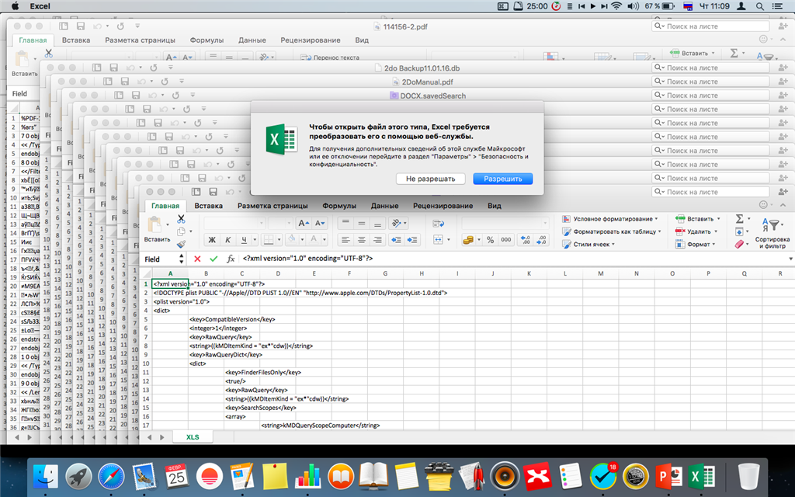

But why?
True story: an independent pharmacist doing an annual analysis to detect potential fraud
With a calculator: Took an entire weekend
With Excel: Took an hour
With R: 1 hour this year, 2 minutes next year
6

Slide 7
R vs. Excel
Both are useful in certain situations
Excel | R
Easy interface | Takes more getting used to
Most tools and options are provided by Microsoft | Anyone can write/download R “libraries” (More than 20,000 freely available)
Need to take notes to remember what you did | The code tells you what you did!
7

Slide 8
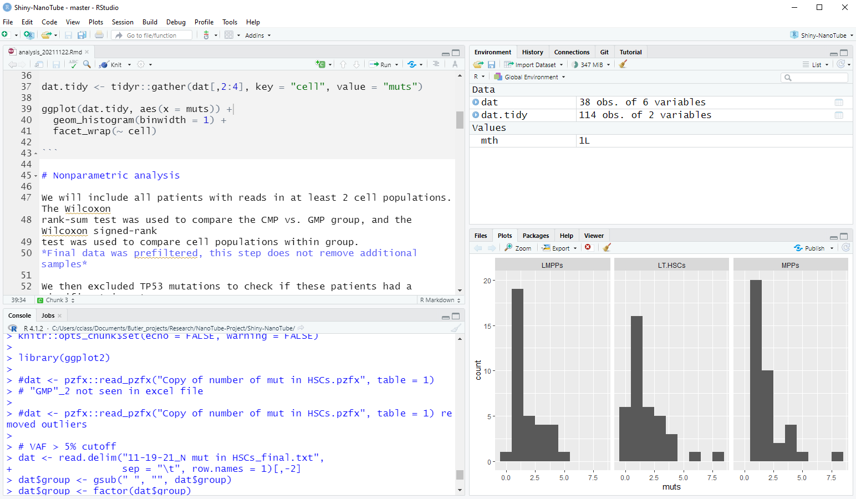
R & RStudio
R is the programming language
numbers = c(12, 33, 30)
mean(numbers)
RStudio is the application where you do the programming
8

